Slide 1
Inversion of Control

Slide 2
The Dependency Inversion Principle
High level modules should not depend upon low level modules. Both should depend upon abstractions.
Abstractions should not depend upon details. Details should depend upon abstractions.

Slide 3
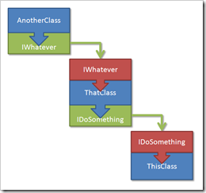
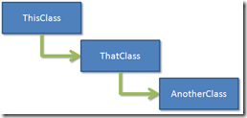
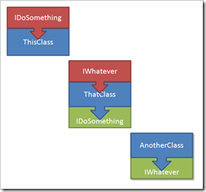
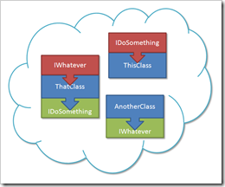
Dependency Inversion example

Slide 4
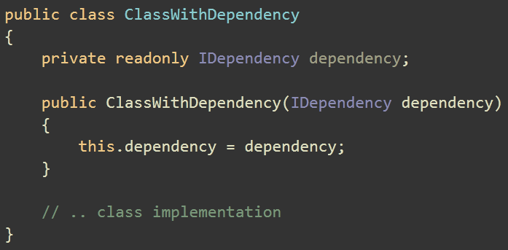
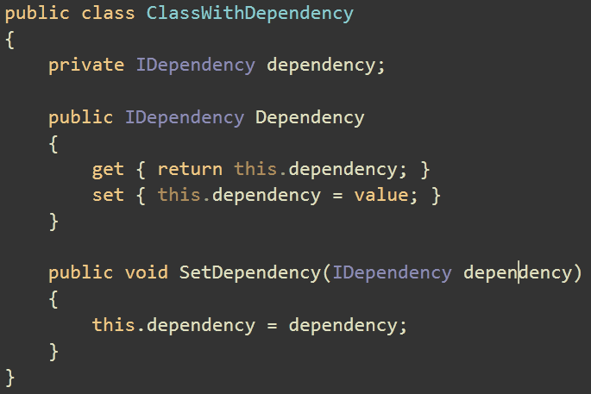
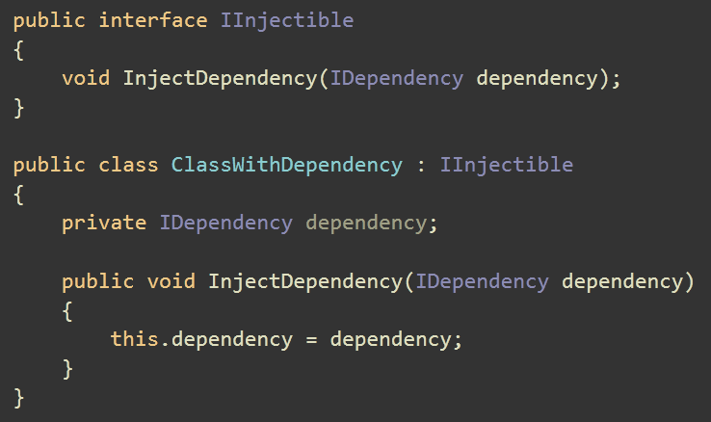
Dependency Injection types by Fowler
Constructor injection
Setter injection
Interface injection

Slide 5
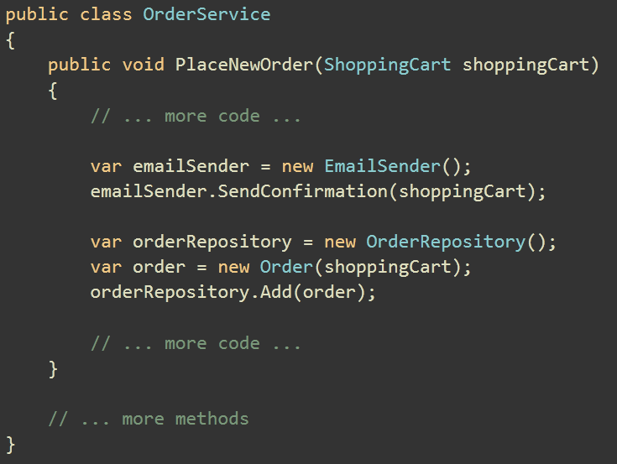
Strongly coupled code

Slide 6
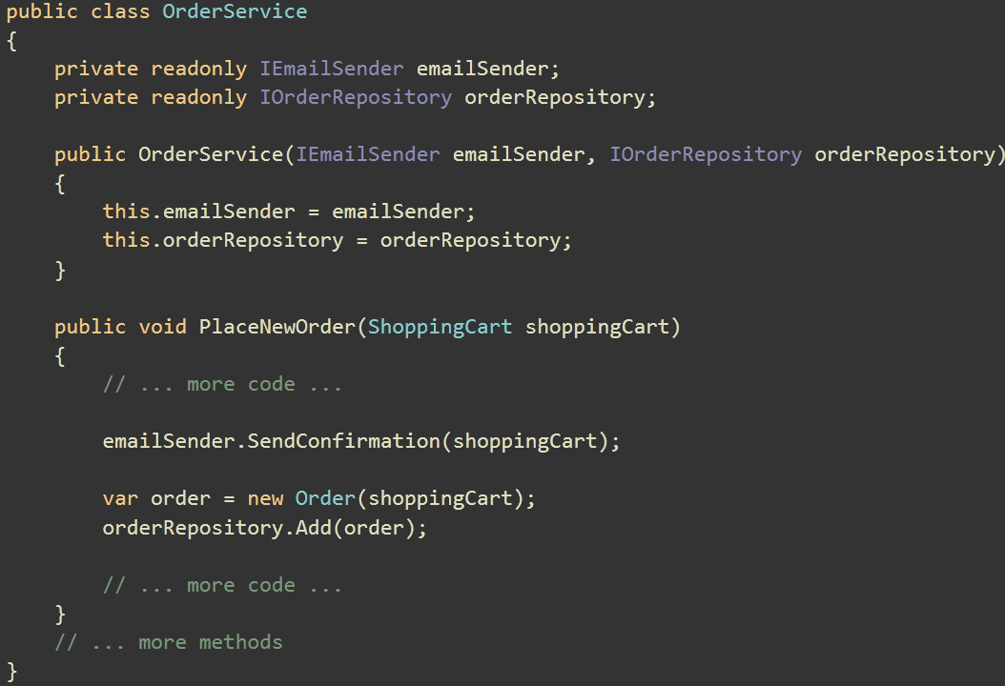
Example with dependency injection

Slide 7
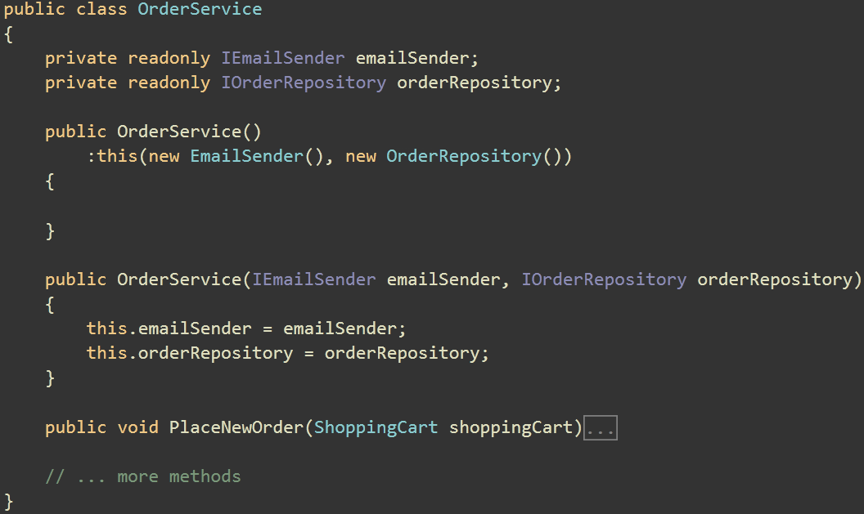
Poor man’s dependency injection

Slide 8
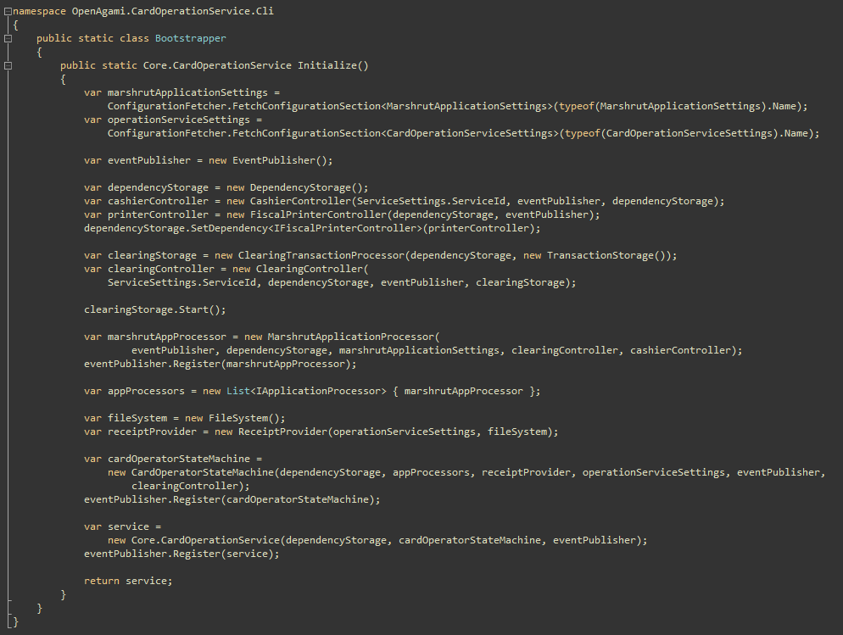
Manual Dependency Injection

Slide 9
.Net dependency injection containers
Autofac
Castle MicroKernel/Windsor
ObjectBuilder
PicoContainer.NET
Puzzle.NFactory
Spring.NET
StructureMap
Ninject
Unity

Slide 10
Modern .Net containers’ features
Instance lifecycle management
Configuration through code using DSL
Auto configuration using conventions
Automocking

